Slide 1

Building & Mining Knowledge Graphs
(KEN4256)
Lab 3: Conversion and Querying

Slide 2
Building KG out of existing data
Technology depends on the data format: CSV, XML, SQL, JSON...
Custom scripts (python, R, java, php)
Extract Transform Load (ETL) tools: no perfect solution or standard for RDF
Mapping languages
Notes:
Monday you saw that we can manually create your own statements. TODO: example RML (short for geonames and worldbank). Give Kody file for Geonames and SAMPLE of Worldbank

Slide 3
One standard to convert relational databases
R2RML: Relational Databases to RDF Mapping Language (W3C recommendation)
A standard language to define conversion scripts:
Easier to write
Easier to share
Easier to maintain
Only for Relational Databases.
Notes:
https://www.w3.org/TR/r2rml/

Slide 4
A unified solution: RML (RDF Mapping Language)
http://rml.io/
A mapping language to rule them all.
Extend the R2RML recommendation to allow conversion of any source:
XML
JSON
CSV
Problem: No implementation to handle big datasets.

Slide 5
RML
Define a Mapping file to map the data source to triples
Execute RML processor: https://github.com/RMLio/rmlmapper-java/releases/download/v4.3.1/rmlmapper.jar
java -jar rmlmapper.jar -m /data/rml/mapping.ttl -o /data/rml/output.nq
-m: mapping file path
-o: output file path
Windows path syntax: C:\data\rml\mapping.ttl

Slide 6
ISO3 | Country | Population | Continent
FRA | France | 70,000,000 | EU
Convert CSV to RDF using RML
<TriplesMapCsv> a rr:TriplesMap; rml:logicalSource [ rml:source "/data/rml/countryInfo.csv"; rml:referenceFormulation ql:CSV ];
Path to the source of the data (filepath)
Notes:
Prefixes used:
@prefix rr: <http://www.w3.org/ns/r2rml#> .
@prefix dc: <http://purl.org/dc/elements/1.1/> .
@prefix dbo: <http://dbpedia.org/ontology/> .
@prefix foaf: <http://xmlns.com/foaf/0.1/> .
@prefix rdfs: <http://www.w3.org/2000/01/rdf-schema#> .
@prefix ex: <http://example.com/> .
@prefix xsd: <http://www.w3.org/2001/XMLSchema#> .
@prefix rml: <http://semweb.mmlab.be/ns/rml#> .
@prefix ql: <http://semweb.mmlab.be/ns/ql#> .
@prefix activity: <http://example.com/activity/> .
@base <http://example.com/base/> .

Slide 7
ISO3 | Country | Population | Continent
FRA | France | 70,000,000 | EU
<http://example.com/country/FRA> a gn:country .
<TriplesMapCsv> a rr:TriplesMap; rml:logicalSource [ rml:source "/data/rml/countryInfo.csv"; rml:referenceFormulation ql:CSV ]; rr:subjectMap [ rr:template "http://geonames.org/country/{ISO3}" ; rr:class gn:country ];
Path to the source of the data (filepath)
Create the subject URI
Notes:
Prefixes used:
@prefix rr: <http://www.w3.org/ns/r2rml#> .
@prefix dc: <http://purl.org/dc/elements/1.1/> .
@prefix dbo: <http://dbpedia.org/ontology/> .
@prefix foaf: <http://xmlns.com/foaf/0.1/> .
@prefix rdfs: <http://www.w3.org/2000/01/rdf-schema#> .
@prefix ex: <http://example.com/> .
@prefix xsd: <http://www.w3.org/2001/XMLSchema#> .
@prefix rml: <http://semweb.mmlab.be/ns/rml#> .
@prefix ql: <http://semweb.mmlab.be/ns/ql#> .
@prefix activity: <http://example.com/activity/> .
@base <http://example.com/base/> .

Slide 8
ISO3 | Country | Population | Continent
FRA | France | 70,000,000 | EU
<http://geonames.org/country/FRA> a gn:country .
<http://geonames.org/country/FRA> rdfs:label “France” .
<TriplesMapCsv> a rr:TriplesMap; rml:logicalSource [ rml:source "/data/rml/countryInfo.csv"; rml:referenceFormulation ql:CSV ]; rr:subjectMap [ rr:template "http://example.com/country/{ISO3}" ; rr:class ex:country ]; rr:predicateObjectMap [ rr:predicate rdfs:label ; rr:objectMap [ rml:reference "Country" ] ] .
Path to the source of the data (filepath)
Create the subject URI
Map the Country column as object
Notes:
Prefixes used:
@prefix rr: <http://www.w3.org/ns/r2rml#> .
@prefix dc: <http://purl.org/dc/elements/1.1/> .
@prefix dbo: <http://dbpedia.org/ontology/> .
@prefix foaf: <http://xmlns.com/foaf/0.1/> .
@prefix rdfs: <http://www.w3.org/2000/01/rdf-schema#> .
@prefix ex: <http://example.com/> .
@prefix xsd: <http://www.w3.org/2001/XMLSchema#> .
@prefix rml: <http://semweb.mmlab.be/ns/rml#> .
@prefix ql: <http://semweb.mmlab.be/ns/ql#> .
@prefix activity: <http://example.com/activity/> .
@base <http://example.com/base/> .

Slide 9
ISO3 | Country | Population | Continent
FRA | France | 70,000,000 | EU
<http://geonames.org/country/FRA> a gn:country .
<http://geonames.org/country/FRA> rdfs:label “France” .
<http://geonames.org/country/FRA> gn:population “70000000”^^xsd:integer .
<TriplesMapCsv> a rr:TriplesMap; rml:logicalSource [ rml:source "/data/rml/countryInfo.csv"; rml:referenceFormulation ql:CSV ]; rr:subjectMap [ rr:template "http://geonames.org/country/{ISO3}" ; rr:class ex:country ]; rr:predicateObjectMap [ rr:predicate gn:population ; rr:objectMap [ rml:reference "Population" ; rr:datatype xsd:integer ] ] ;
Path to the source of the data (filepath)
Create the subject URI
The object is an integer
Notes:
Prefixes used:
@prefix rr: <http://www.w3.org/ns/r2rml#> .
@prefix dc: <http://purl.org/dc/elements/1.1/> .
@prefix dbo: <http://dbpedia.org/ontology/> .
@prefix foaf: <http://xmlns.com/foaf/0.1/> .
@prefix rdfs: <http://www.w3.org/2000/01/rdf-schema#> .
@prefix ex: <http://example.com/> .
@prefix xsd: <http://www.w3.org/2001/XMLSchema#> .
@prefix rml: <http://semweb.mmlab.be/ns/rml#> .
@prefix ql: <http://semweb.mmlab.be/ns/ql#> .
@prefix activity: <http://example.com/activity/> .
@base <http://example.com/base/> .

Slide 10
ISO3 | Country | Population | Continent
FRA | France | 70,000,000 | EU
<http://geonames.org/country/FRA> a gn:country .
<http://geonames.org/country/FRA> rdfs:label “France” .
<http://geonames.org/country/FRA> gn:population “70000000”^^xsd:integer .
<http://geonames.org/country/FRA> gn:partOf <http://geonames.org/continent/EU> .
<TriplesMapCsv> a rr:TriplesMap; rml:logicalSource [ rml:source "/data/rml/countryInfo.csv"; rml:referenceFormulation ql:CSV ]; rr:subjectMap [ rr:template "http://geonames.org/country/{ISO3}" ; rr:class gn:country ]; rr:predicateObjectMap [ rr:predicate gn:continent ; rr:objectMap [ rr:template "http://geonames.org/continent/{Continent}" ] ] ;
Path to the source of the data (filepath)
Create the subject URI
Create URI as object
Notes:
Prefixes used:
@prefix rr: <http://www.w3.org/ns/r2rml#> .
@prefix dc: <http://purl.org/dc/elements/1.1/> .
@prefix dbo: <http://dbpedia.org/ontology/> .
@prefix foaf: <http://xmlns.com/foaf/0.1/> .
@prefix rdfs: <http://www.w3.org/2000/01/rdf-schema#> .
@prefix ex: <http://example.com/> .
@prefix xsd: <http://www.w3.org/2001/XMLSchema#> .
@prefix rml: <http://semweb.mmlab.be/ns/rml#> .
@prefix ql: <http://semweb.mmlab.be/ns/ql#> .
@prefix activity: <http://example.com/activity/> .
@base <http://example.com/base/> .

Slide 11
<Root >
<data>
<record>
<country key="FRA">France</country>
<year>1960</year>
<value>62651474946.6007</value>
</record>
XML
<http://data.wordbank.org/country/FRA> a wb:country .
<http://data.wordbank.org/country/FRA> rdfs:label “France” .
<TriplesMapXml> a rr:TriplesMap; rml:logicalSource [ rml:source "/data/rml/gdp_worldbank.xml"; rml:referenceFormulation ql:XPath; rml:iterator "/Root/data/record" ] ; rr:subjectMap [ rr:template "http://data.worldbank.org/{country/@key}/gdp/{year}" ; rr:class wb:GdpEntry ]; rr:predicateObjectMap [ rr:predicate wd:country ; rr:objectMap [ rml:reference "country/@key" ] ] .
Path to the source of the data (filepath)
And XPath iteration
Create yearly entry for each country
Define the country of the GDP entry
Notes:
Prefixes used:
@prefix rr: <http://www.w3.org/ns/r2rml#> .
@prefix dc: <http://purl.org/dc/elements/1.1/> .
@prefix dbo: <http://dbpedia.org/ontology/> .
@prefix foaf: <http://xmlns.com/foaf/0.1/> .
@prefix rdfs: <http://www.w3.org/2000/01/rdf-schema#> .
@prefix ex: <http://example.com/> .
@prefix xsd: <http://www.w3.org/2001/XMLSchema#> .
@prefix rml: <http://semweb.mmlab.be/ns/rml#> .
@prefix ql: <http://semweb.mmlab.be/ns/ql#> .
@prefix activity: <http://example.com/activity/> .
@base <http://example.com/base/> .

Slide 12
Your Tasks
Task 1 Download and install RML Processor Download example RML mapping file & WorldBank dataset from Student Portal Execute the RML mapping file to convert the World Bank data to RDF Check the output file to verify if the data was successfully converted Task 2 Extend the RML mapping file to convert two more columns of the WorldBank dataset Execute the extended RML mapping file Verify the output file again Material https://github.com/MaastrichtU-IDS/um-kg-course

Slide 13
Using an ontology
Using a data model, a common way to represent data that makes sense to other people:
A generic model: http://mappings.dbpedia.org/server/ontology/classes/
A model for experts: http://www.geonames.org/ontology/ontology_v3.1.rdf
Which class define the meaning of your subject the best?
Notes:
Also called Shared vocabulary
http://dbpedia.org/ontology/grossDomesticProduct
http://mappings.dbpedia.org/server/ontology/classes/GrossDomesticProduct

Slide 14
Questions?
Notes:
TODO: next time add a slide to say exactly where and how to change oath location in command and file

Slide 15
Querying Knowledge Bases

Slide 16
Querying Data
Using SPARQL query language https://www.w3.org/TR/rdf-sparql-query/
SPARQL (pronounced sparkle) stands for: SPARQL Protocol And RDF Query Language
SPARQL 1.0 W3C-Recommendation since January 15th 2008 SPARQL 1.1
W3C-Recommendation since March 21st 2013 Query language to query instances in RDF documents
Great practical importance (almost all applications need it) to query data stored in a graph

Slide 17
SPARQL Query - Example
SELECT * WHERE {
?subject ?predicate ?object . }

Slide 18
SPARQL Components
A SPARQL query comprises, in order:
PREFIX declarations, for abbreviating URIs
Dataset definition, stating what RDF graph(s) are being queried
A result clause, identifying what information to return from the query
The query pattern, specifying what to query for in the underlying dataset
Query modifiers, slicing, ordering, and otherwise rearranging query results
Notes:
Could we do a break down of a full query, pointing out the different parts (prefix, select variables, FROM, where, filter, ordering…)?

Slide 19
SPARQL Components
# prefix declarations PREFIX foo: <http://example.com/resources/> # dataset definition (optional) FROM # result clause SELECT # query pattern WHERE { ... } # query modifiers ORDER BY ...
Notes:
Dataset definition: graph filtering, optional

Slide 20
SPARQL Example
SELECT * WHERE {
?book rdf:type <http://dbpedia.org/ontology/Book> . }

Slide 21
SPARQL Example
PREFIX dbo:<http://dbpedia.org/ontology/> SELECT * WHERE { ?book a dbo:Book .
?book dbo:author ?author . }
Try it yourself:
http://dbpedia.org/sparql

Slide 22
SPARQL Example
PREFIX dbo:<http://dbpedia.org/ontology/> SELECT * WHERE { ?book a dbo:Book
?book dbo:author ?author } LIMIT 10
What’s wrong with this query?

Slide 23
SPARQL Example - Retrieving specific entities
PREFIX dbo:<http://dbpedia.org/ontology/> SELECT ?author WHERE { ?book a dbo:Book .
?book dbo:author ?author . } LIMIT 10

Slide 24
Using FILTER
Comparison operators: <, =, >, <=, >=, !=
Comparison of data literals according to natural order
Support for numerical data types, xsd:dateTime, xsd:string (alphabetic ordering), xsd:Boolean (1>0)
For other types and other RDF-elements, only = and != are available Comparison of literals of incompatible types (e.g. xsd:string and xsd:integer) is not allowed
Arithmetic operators: +, -, *, /
Support for numerical data types
Used to combine values in filter conditions Ex.: FILTER(?weight/ (?size*?size)>=25)

Slide 25
Using FILTER
PREFIX dbo:<http://dbpedia.org/ontology/> SELECT DISTINCT ?author WHERE { ?book a dbo:Book .
?book dbo:author ?author .
?book dbo:numberOfPages ?pages . FILTER (?pages > 500) } LIMIT 10

Slide 26
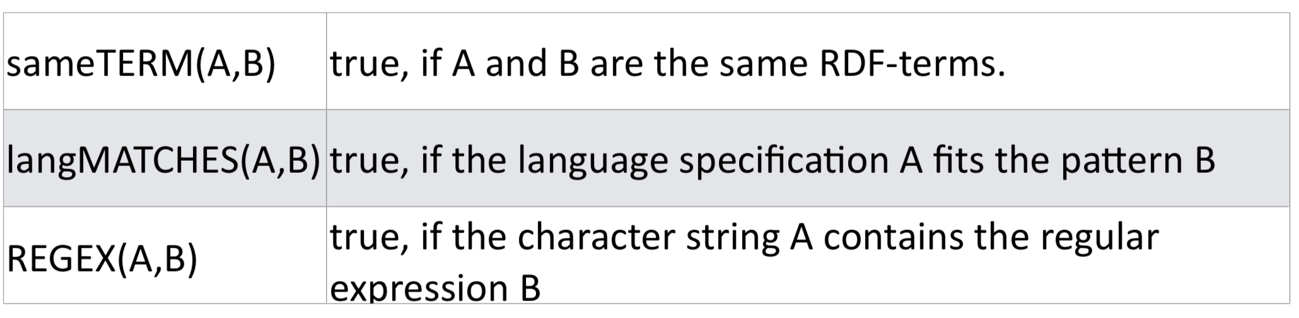
Special FILTER Functions

Slide 27
Special FILTER Functions
PREFIX dbo:<http://dbpedia.org/ontology/> PREFIX dbp:<http://dbpedia.org/property/> SELECT * WHERE { ?book a dbo:Book .
?book dbo:author ?author .
?book dbo:numberOfPages ?pages .
?book dbp:name ?name . FILTER (?pages > 500) FILTER regex(?name,"en") } LIMIT 10

Slide 28
FILTER Functions: Boolean Operators
Filter conditions can be linked with boolean operators: &&, ||, !
Partially also expressible through graph pattern:
Conjunction corresponds to specifications of several filters
Disjunction corresponds to application of filters in alternative patterns

Slide 29
SORTING Results
How can one retrieve defined parts of the output set?
How are the results ordered?
Can duplicate result rows be removed instantaneously?

Slide 30
SORTING Results
SELECT * WHERE { ?book a dbo:Book .
?book dbo:author ?author .
?book dbo:numberOfPages ?pages .
?book dbp:name ?name. FILTER (?pages > 500) FILTER regex(?name,"en") } ORDER BY ?pages LIMIT 10

Slide 31
ORDERING Results
Other possible specifications: • ORDER BY DESC(?price): descending • ORDER BY ASC(?price): ascending, default seong • ORDER BY DESC(?price), ?Ftle: hierarchical classification criteria

Slide 32
LIMIT, OFFSET, DISTINCT
Restriction of output set:
LIMIT: maximal number of results (table rows)
OFFSET: position of the first delivered result SELECT
DISTINCT: removal of duplicate table rows
LIMIT and OFFSET only make sense with ORDER BY!

Slide 33
DESCRIBE
DESCRIBE <http://dbpedia.org/resource/Maastricht>
The DESCRIBE query result clause allows the server to return whatever RDF it wants that describes the given resource(s).

Slide 34
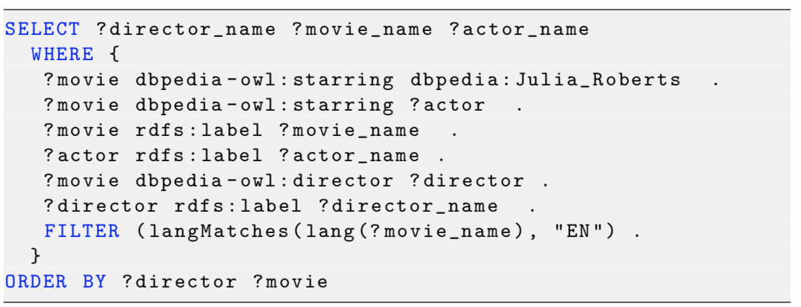
Test - What is this query doing?

Slide 35
SPARQL DIY
Countries with population greater than 10,000,000 inhabitants
Musicians who were born in a country with more than 10,000,000 inhabitants
Films starring Richard Gere and starring Julia Roberts
TIPS:
View the resource as NTriples to construct your query
Use http://prefix.cc to look up prefixes
Always use LIMIT
Start by getting results one triple at a time and build up

Slide 36
Summary: SPARQL query breakdown
PREFIX dbo:<http://dbpedia.org/ontology/> PREFIX dbp:<http://dbpedia.org/property/> SELECT ?name ?author WHERE { ?book a dbo:Book . ?book dbo:author ?author . ?book dbo:numberOfPages ?pages . ?book dbp:name ?name . FILTER (?pages > 500) FILTER (langMATCHES(LANG(?name),"en")) } ORDER BY ?pages LIMIT 10
Prefix declarations
Variables to display in the results
Where clause to define the triples to select
Patterns of triples to select
Filter triples
Order by, group by, limit clauses

Slide 37
Questions?

